Slide 1
Unit_6 Input Output (I/O)Management

Slide 2
I/O Management
One of the important jobs of an Operating System is to manage various I/O devices including mouse, keyboards, touch pad, disk drives, display adapters, USB devices, On/off switch, network connections, printers etc.
An I/O system is required to take an application I/O request and send it to the physical device, then take whatever response comes back from the device and send it to the application.
I/O devices can be divided into two categories:
Block devices − A block device is one with which the driver communicates by sending entire blocks of data. For example, Hard disks, USB cameras, Disk-On-Key etc.
Character devices − A character device is one with which the driver communicates by sending and receiving single characters (bytes, octets). For example, serial ports, parallel ports, sounds cards etc

Slide 3
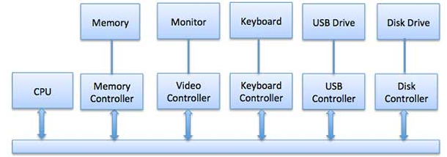
Device Controllers
Device drivers are software modules that can be plugged into an OS to handle a particular device.
Operating System takes help from device drivers to handle all I/O devices.
The Device Controller works like an interface between a device and a device driver.

Slide 4
Communication to I/O Devices
The CPU must have a way to pass information to and from an I/O device.
There are different approaches available to communicate with the CPU and Device.
Memory-mapped I/O
Direct memory access (DMA)

Slide 5
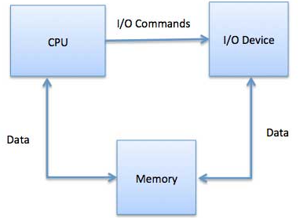
Memory-mapped I/O
When using memory-mapped I/O, the same address space is shared by memory and I/O devices.
The device is connected directly to certain main memory locations so that I/O device can transfer block of data to/from memory without going through CPU.

Slide 6
Direct Memory Access (DMA)
Direct Memory Access(DMA) is a technique used to facilitate data transfers between I/O devices and main memory without involving the central processing unit (CPU).
DMA is employed to improve overall system performance by reducing CPU involvement in data transfers, freeing up the CPU to perform other tasks while data is moved in the background.
When an I/O device needs to transfer data to or from the main memory, the traditional method involves the CPU coordinating the entire data transfer process.
This process typically consists of the following steps:

Slide 7
I/O Device Request: The I/O device sends a request to the CPU, indicating that it needs to read from or write to main memory.
CPU Involvement: The CPU performs the following tasks:
a. The CPU receives the request from the device and performs any necessary tasks before initiating the data transfer.
b. The CPU reads data from the device or provides data to the device, acting as an intermediary in the transfer.
c. The CPU then writes the data to or reads the data from the main memory.
Acknowledgment: Once the data transfer is complete, the CPU informs the I/O device, and the device continues its operation.
This process introduces significant overhead, as the CPU must spend time for resources handling the data transfer, which can be particularly bulky for large data transfers.

Slide 8
DMA solves this problem by allowing the I/O device to access main memory directly without the intervention of the CPU.
Here's how DMA works:
DMA Controller: The system includes a specialized hardware component called the DMA controller (or DMA engine), which manages DMA operations. The DMA controller is connected to the system bus, the CPU, and the I/O devices.
Initialization: Before starting a DMA transfer, the CPU sets up the DMA controller by providing it with the necessary parameters, such as the source and destination addresses in main memory, the amount of data to transfer, and the direction of the transfer (read from the device or write to the device).
Data Transfer: Once the DMA controller is configured, it takes control of the system bus and initiates the data transfer directly between the I/O device and main memory, bypassing the CPU. The DMA controller can transfer entire blocks of data with minimal CPU involvement.
Interrupt or Notification: Once the DMA transfer is complete, the DMA controller can generate an interrupt or send a notification to the CPU to inform it about the successful completion of the data transfer.

Slide 9
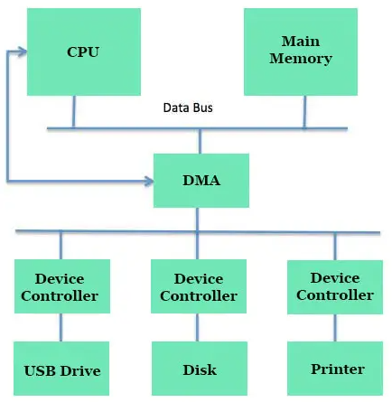

Slide 10
Handling I/O
Handling I/O (Input/Output) in an operating system involves managing communication with peripheral devices and facilitating data transfers between the central processing unit (CPU) and external devices.
I/O handling is a critical function of the OS as it enables applications to interact with various hardware components.

Slide 11
Programmed I/O
Programmed I/O (Input/Output) is a simple method of handling I/O operations in an operating system where the CPU is directly involved in the data transfer between the I/O device and memory.
In programmed I/O, the CPU explicitly issues commands to read from or write to the I/O device and transfers data between the device and memory one byte or word at a time.
It is a straightforward and easy-to-implement technique but can be inefficient for certain types of I/O operations.

Slide 12
Interrupt Driven I/O
Interrupt-driven I/O (Input/Output) is an efficient technique used in operating systems to handle I/O operations.
Unlike programmed I/O, where the CPU is directly involved in data transfer and busy-waits for the completion of I/O operations, interrupt-driven I/O allows the CPU to perform other tasks while the data transfer between the I/O device and memory is taking place.
Interrupt-driven I/O significantly reduces CPU overhead and enhances overall system performance.

Slide 13
I/O using DMA

Slide 14
Interrupt Handlers
Interrupt handlers, also known as interrupt service routines (ISRs), are crucial components of an operating system that handle hardware interrupts generated by various hardware devices.
When an I/O device or hardware component needs attention from the CPU or has completed an operation, it sends an interrupt request (IRQ) signal to the CPU, indicating that it requires immediate attention.
The CPU then interrupts the current execution of the running process and transfers control to the appropriate interrupt handler.

Slide 15
Here's how interrupt handlers work in an OS:
Interrupt Occurrence: When an I/O device or hardware component needs to notify the CPU about a specific event, such as the completion of an I/O operation, an error, or a request for service, it generates an interrupt request (IRQ).
Interrupt Vector Table: When the CPU receives an interrupt, it consults the interrupt vector table to determine the appropriate interrupt handler to execute. The interrupt vector table is a data structure in memory that contains addresses of all the possible interrupt handlers in the operating system.
Context Switch: Before calling the interrupt handler, the CPU performs a context switch to save the state of the current process. This ensures that the CPU can resume the interrupted process correctly after the interrupt handler finishes its execution.
Execution of the Interrupt Handler: The interrupt handler executes the necessary operations to handle the specific interrupt event. This may involve processing incoming data, signaling the completion of an I/O operation, handling errors, or managing other hardware-related tasks.
Interrupt Priority: If multiple interrupts occur simultaneously, the OS may employ interrupt prioritization mechanisms to determine which interrupt to handle first. Higher-priority interrupts may preempt lower-priority interrupts to ensure critical events are addressed promptly.
Resuming Execution: After the interrupt handler completes its tasks, it performs another context switch to restore the saved state of the interrupted process. The CPU then resumes the execution of the interrupted process from the point where it was interrupted.

Slide 16
Device Drivers
Device drivers are software components within an operating system that act as intermediaries between the operating system and specific hardware devices.
Their primary function is to enable the operating system to communicate with various hardware components efficiently and abstract the complexities of hardware interactions from higher-level software, such as applications and system services.
Device drivers play a crucial role in ensuring proper device functionality, allowing the OS to manage I/O operations and maintain compatibility with a wide range of hardware devices.

Slide 17
Disk Scheduling
A process needs two type of time, CPU time and IO time.
For I/O, it requests the Operating system to access the disk.
Disk scheduling is a technique used by the operating system to schedule multiple requests for accessing the disk.
The algorithms used for disk scheduling are called as disk scheduling algorithms.
The purpose of disk scheduling algorithms is to reduce the total seek time.
Seek Time : Seek time is the time taken in locating the disk arm to a specified track where the read/write request will be satisfied.
There are FCFS, SSTF (shortest seek time first) , SCAN scheduling, C-SCAN scheduling, LOOK Scheduling and C-LOOK scheduling

Slide 18
FCFS Disk Scheduling Algorithm
FCFS algorithm entertains requests in the order they arrive in the disk queue.
It is the simplest disk scheduling algorithm.
Advantages
It is simple, easy to understand and implement.
It does not cause starvation to any request.
Disadvantages
It results in increased total seek time.
It is inefficient.

Slide 19
Example
Consider a disk queue with requests for I/O to blocks on cylinders 98, 183, 41, 122, 14, 124, 65, 67. The FCFS scheduling algorithm is used. The head is initially at cylinder number 53. The cylinders are numbered from 0 to 199. Calculate the total head movement (in number of cylinders) while servicing these requests.

Slide 20
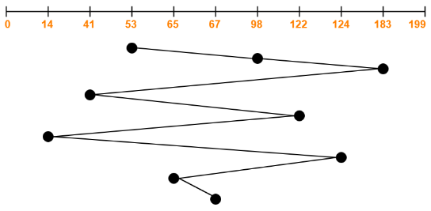
Soln:
Total head movements incurred while servicing these requests
= (98 – 53) + (183 – 98) + (183 – 41) + (122 – 41) + (122 – 14) + (124 – 14) + (124 – 65) + (67 – 65)
= 45 + 85 + 142 + 81 + 108 + 110 + 59 + 2
= 632

Slide 21
Question
Consider the following disk request sequence for a disk with 100 tracks 45, 21, 67, 90, 4, 50, 89, 52, 61, 87, 25
Head pointer starting at 50 and moving in left direction. Find the number of head movements in cylinders using FCFS scheduling.

Slide 22
SSTF Scheduling Algorithm
Shortest seek time first (SSTF) algorithm selects the disk I/O request which requires the least disk arm movement from its current position.
It reduces the total seek time as compared to FCFS.
It allows the head to move to the closest track in the service queue.

Slide 23
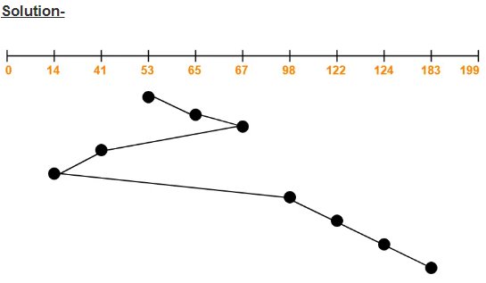
Consider a disk queue with requests for I/O to blocks on cylinders 98, 183, 41, 122, 14, 124, 65, 67. The SSTF scheduling algorithm is used. The head is initially at cylinder number 53 moving towards larger cylinder numbers on its servicing pass. The cylinders are numbered from 0 to 199. Find the total head movement (in number of cylinders).
Total head movements incurred while servicing these requests
= (65 – 53) + (67 – 65) + (67 – 41) + (41 – 14) + (98 – 14) + (122 – 98) + (124 – 122) + (183 – 124)
= 12 + 2 + 26 + 27 + 84 + 24 + 2 + 59
= 236

Slide 24
Question
Consider the following disk request sequence for a disk with 100 tracks 45, 21, 67, 90, 4, 89, 52, 61, 87, 25
Head pointer starting at 50 and moving in left direction. Find the number of head movements in cylinders using SSTF scheduling.

Slide 25
SCAN Algorithm
Scans all the cylinders of the disk back and forth.
Head starts from one end of the disk and move towards the other end servicing all the requests in between.
After reaching the other end, head reverses its direction and move towards the starting end servicing all the requests in between.
The same process repeats.
SCAN Algorithm is also called as Elevator Algorithm.

Slide 26
Consider a disk queue with requests for I/O to blocks on cylinders 98, 183, 41, 122, 14, 124, 65, 67. The SCAN scheduling algorithm is used. The head is initially at cylinder number 53 moving towards larger cylinder numbers on its servicing pass. The cylinders are numbered from 0 to 199. Find the total head movement.

Slide 27
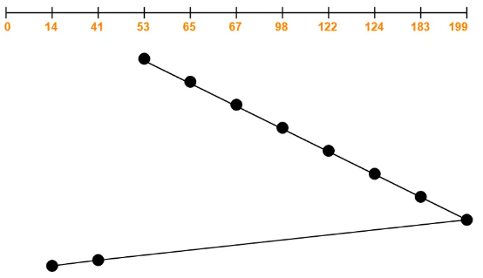
Total head movements
= (65 – 53) + (67 – 65) + (98 – 67) + (122 – 98) + (124 – 122) + (183 – 124) + (199 – 183) + (199 – 41) + (41 – 14)
= 12 + 2 + 31 + 24 + 2 + 59 + 16 + 158 + 27
= 331
Alternatively,
Total head movements incurred while servicing these requests
= (199 – 53) + (199 – 14)
= 146 + 185
= 331

Slide 28
Question
Consider the following disk request sequence for a disk with 100 tracks 45, 21, 67, 90, 4, 89, 52, 61, 87, 25. Head pointer starting at 50 and moving in left direction. Find the number of head movements in cylinders using SCAN scheduling.

Slide 29
C-SCAN Disk Scheduling Algorithm
Circular-SCAN(C-SCAN) Algorithm is a variant of the SCAN Algorithm.
Head starts from one end of the disk and move towards the other end servicing all the requests in between.
After reaching the other end, head reverses its direction.
It then returns to the starting end without servicing any request in between.
The same process repeats.

Slide 30
Consider a disk queue with requests for I/O to blocks on cylinders 98, 183, 41, 122, 14, 124, 65, 67. The C-SCAN scheduling algorithm is used. The head is initially at cylinder number 53 moving towards larger cylinder numbers on its servicing pass. The cylinders are numbered from 0 to 199. Find the total head movement.

Slide 31
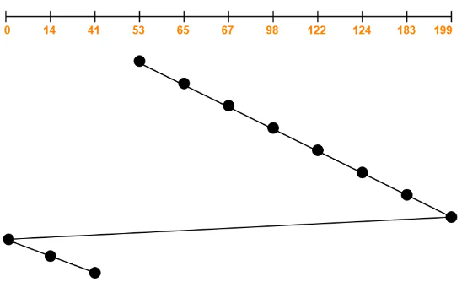
Total head movements incurred while servicing these requests
= (65 – 53) + (67 – 65) + (98 – 67) + (122 – 98) + (124 – 122) + (183 – 124) + (199 – 183) + (199 – 0) + (14 – 0) + (41 – 14)
= 12 + 2 + 31 + 24 + 2 + 59 + 16 + 199 + 14 + 27
= 386
Alternatively,
Total head movements incurred while servicing these requests
= (199 – 53) + (199 – 0) + (41 – 0)
= 146 + 199 + 41
= 386

Slide 32
Question
Consider the following disk request sequence for a disk with 100 tracks 45, 21, 67, 90, 4, 89, 52, 61, 87, 25. Head pointer starting at 50 and moving in left direction. Find the number of head movements in cylinders using C- SCAN scheduling.

Slide 33
LOOK Disk Scheduling Algorithm
LOOK Algorithm is an improved version of the SCAN Algorithm.
Head starts from the first request at one end of the disk and moves towards the last request at the other end servicing all the requests in between.
After reaching the last request at the other end, head reverses its direction.
It then returns to the first request at the starting end servicing all the requests in between.
The same process repeats.

Slide 34
Consider a disk queue with requests for I/O to blocks on cylinders 98, 183, 41, 122, 14, 124, 65, 67. The LOOK scheduling algorithm is used. The head is initially at cylinder number 53 moving towards larger cylinder numbers on its servicing pass. The cylinders are numbered from 0 to 199. Find the total head movement.

Slide 35
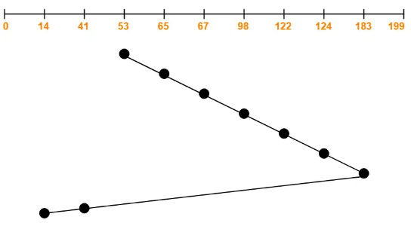
Total head movements
= (65 – 53) + (67 – 65) + (98 – 67) + (122 – 98) + (124 – 122) + (183 – 124) + (183 – 41) + (41 – 14)
= 12 + 2 + 31 + 24 + 2 + 59 + 142 + 27
= 299
Alternatively,
Total head movements incurred while servicing these requests
= (183 – 53) + (183 – 14)
= 130 + 169
= 299

Slide 36
Question
Consider the following disk request sequence for a disk with 100 tracks 45, 21, 67, 90, 4, 89, 52, 61, 87, 25. Head pointer starting at 50 and moving in left direction. Find the number of head movements in cylinders using Look scheduling.

Slide 37
C-LOOK Disk Scheduling Algorithm
Circular-LOOK Algorithm is a variant of the LOOK Algorithm.
Head starts from the first request at one end of the disk and moves towards the last request at the other end servicing all the requests in between.
After reaching the last request at the other end, head reverses its direction.
It then returns to the first request at the starting end without servicing any request in between.
The same process repeats.

Slide 38
Consider a disk queue with requests for I/O to blocks on cylinders 98, 183, 41, 122, 14, 124, 65, 67. The C- LOOK scheduling algorithm is used. The head is initially at cylinder number 53 moving towards larger cylinder numbers on its servicing pass. The cylinders are numbered from 0 to 199. Find the total head movement.

Slide 39
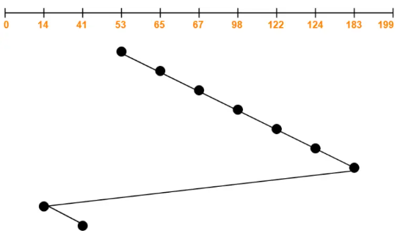
Total head movements
= (65 – 53) + (67 – 65) + (98 – 67) + (122 – 98) + (124 – 122) + (183 – 124) + (183 – 14) + (41 – 14)
= 12 + 2 + 31 + 24 + 2 + 59 + 169 + 27
= 326
Alternatively,
Total head movements
= (183 – 53) + (183 – 14) + (41 – 14)
= 130 + 169 + 27
= 326

Slide 40
Question
Consider the following disk request sequence for a disk with 100 tracks 45, 21, 67, 90, 4, 89, 52, 61, 87, 25. Head pointer starting at 50 and moving in left direction. Find the number of head movements in cylinders using C-Look scheduling.

